Slide 1

Web Dev 101
Session 2
Further HTML
Attributes, Classes and IDs
File Organisation
Using Ext Libraries
CSS
Learning Resources
Esraa Dandash 19/11/2018

Slide 2
Further HTML
Go to https://github.com/eydandash/CityTechSoc-WebDev-101/
Bookmark this page if you would like to reach it easily every session.
Download Session 2 and you can check the resources in the recourses menu for second session.
Open index.html in your text editor (Exercise 2)
Follow the comments to add the HTML tags that we will go through today: new ones include nav, image, link, list, table and line break.
Add attributes as defined in the comments.

Slide 3
File Organisation
Website
media
libraries
CSS
HTML files
To use external styling sheets, libraries or media (images) we always have to include them in the header tags of our HTML files or link them in the attributes for their relevant tags in the HTML body.
`

Slide 4
CSS
A language that describes the style of an HTML document.
CSS describes how HTML elements should be displayed.
Create a new styling sheet, and name it style.css, then save it in Exercise 2.
Change the font of all elements in body to your own favourite Google Font chosen from the resources link. (check resources)
Save and refresh, any changes??
Link it.
Go ahead and do the following changes to the html elements:
Change Header font size to 30px, font-weight to 400, and color to white.
Change the column width to fit the page, and bg-color the middle rows black and font white. (hint: use classes) , then add borders to it.

Slide 5
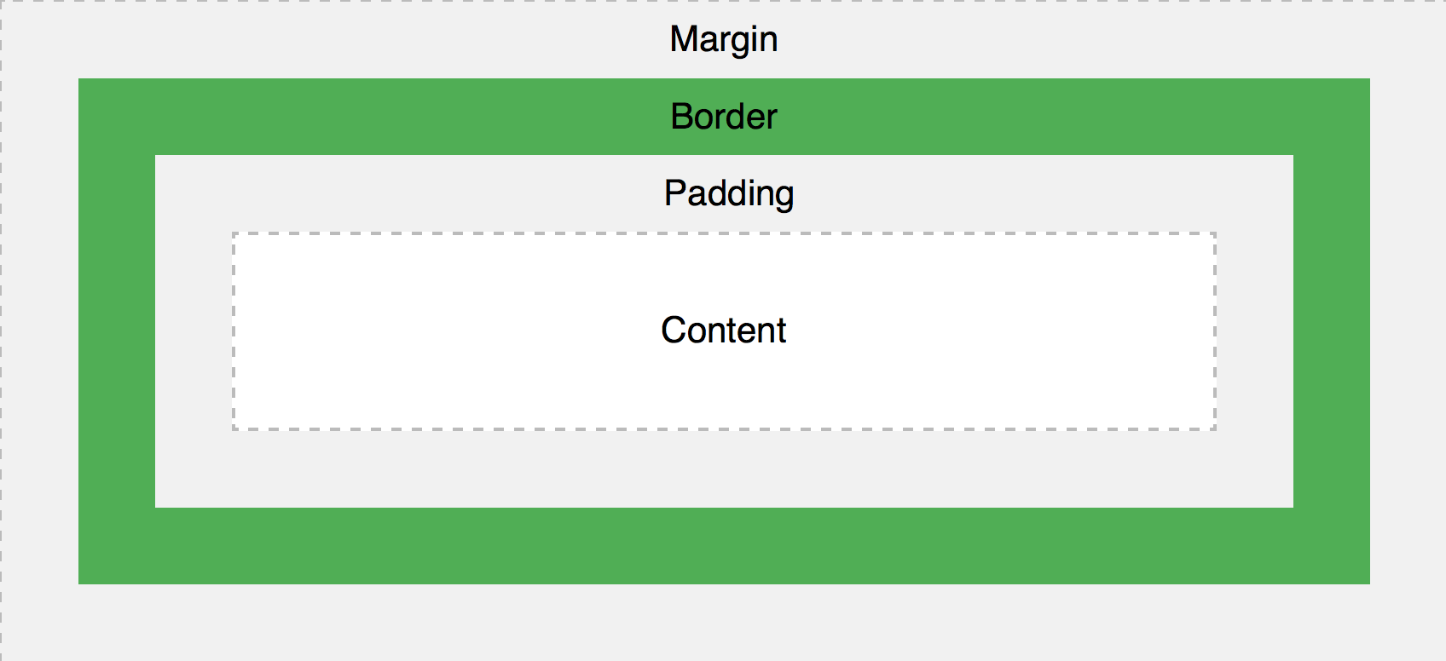
CSS
Set navbar height to 30 px, padding to 5 px, background colour to your chosen colour.
Add a border to your navbar, color blue, solid, 3 px.
Add class to the rest of the body, then style it to have a background of your choice from Unsplash (in resources)!
See you next Monday 💻💥

